Slide 1
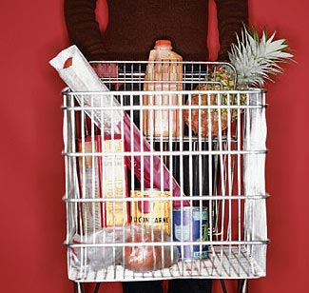


On-Demand Factory
June 16, 2004
IRI Enterprise Business Rules Solution

Slide 2
Agenda – Business Rules Solution
Business Rule Benefits
Key IRI Business Benefits
What is a Business Rule at IRI?
Business Rule Candidates at IRI
Enterprise Business Rule Architecture
Store Level QC POC Example
Business Rule Management Team Organization
Estimated IRI ROI
Estimated IRI Costs
Why ILOG?
Conclusion/Next Steps
Copyright © Information Resources, Inc. 2004. Confidential and proprietary.
Notes:
Copyright © Information Resources, Inc. 2004. Confidential and proprietary.

Slide 3
Business Rules Benefits
Maintainability (development and testing) of Complex Business Logic by the Business Analyst that Developed the Logic
Centralized Repository for Business Logic Management
Reuse of Business Logic
Track Changes to the Business Logic
Categorization of Business Logic
Changeability of Business Logic
Traceability of Business Rules, Business Objects and their Relationships
Copyright © Information Resources, Inc. 2004. Confidential and proprietary.
Notes:
Copyright © Information Resources, Inc. 2004. Confidential and proprietary.

Slide 4
Key Business Benefits
Reduction of Error and Lateness Penalties
Reduce Restatement and Reprocessing Costs
Reduction of Maintenance FTEs
Quick Changes to Systems to Meet Market and Client Demands
Quick Changes to Systems to Meet Real World Changes (e.g., Daily Data, $100M Grocery Stores)
Improved Data Quality Needed to Meet 100% Customer Satisfaction by Monitoring Different Aspects of Data Quality as Needed

Slide 5
Key Business Benefits (Cont.)
Stratification of Defect Tracking (Six Sigma)
Turn Resource Expertise into an IRI Corporate Asset
Transparent Process Audit and Traceability
Quicker Development of New Systems because of the Testing and Implementation of Business Logic by the Business Analysts
Business Rule and Business Object Lineage
Grow a System Over Time (You do not have to know all possibilities at the beginning.)

Slide 6
What Are Business Rules at IRI?
Business Rules (Business Rules System)
  An individual Decision Point that is Maintained Outside of a Program in a Central Business Rule Repository
  All Other Rule Classes are Maintained in Specific Systems
  If-Then Business Logic Statements in Programs (SAS, C, Perl, PL1, Scripts, VB, .NET, Oracle Forms, PL/SQL, etc.)
    All Business Logic will be Separated Out from the Programming Logic and Turned into Business Rules
    One of the Main Sources of Business Rules
Copyright © Information Resources, Inc. 2004. Confidential and proprietary.
Notes:
Copyright © Information Resources, Inc. 2004. Confidential and proprietary.

Slide 7
What Are NOT Business Rules at IRI
Non-Business Rule Classes
  Parsing Patterns (Handled by the Parsing Tool)
  Matching Rules (Handled by the Matching Tool)
  Standardization Rules (Handled by the Standardization Tool)
  Transformation Rules (Handled by ETL Tool)
  Configuration Rules (Handled by the Configuration Tool)
  ETL Business Rules (These are usual a One Rule Decision and are Handled by ETL Tool)

Slide 8
English Business Rules Example (StoreQC POC)
There has been a decrease of 40% or more in total sales dollars, total number of UPC's, and total units as well as a 60% decrease in the number of top UPCs.
Changing sales occurs when the previous week was a holiday. There has been an increase of 20-40% in total sales, total moving UPCs, and total units for current week. The number of duplicates is less than 30% of total items, and the number of units one is less than 50% of total items with a stable top 100 item measure for current week. There has not been a decrease of more than 40% in total sales or total units for current week. There has not been an increase of more than 30% in average price for current week. The current week has display information.

Slide 9
Rule Features Needed for Rule Examples
Maintained in English Format in a Form Understood by the Business Analyst
Maintained by Business Analysts by Using Templates
Finite Choices are Menu Driven
Values such as Numbers and Percentages can be Quickly Changed
Reuse of Internal Measures Across Multiple Rules
Reuse of Rules Across Multiple Application Spaces
Maintained in a Single Rule Repository
Business Rule and Business Object Lineage Capabilities (Needed for Data Integration)

Slide 10
Business Rule Candidates at IRI
Data Loading Store and UPC Level QC including SOP’s
  1,500 Rules
  60,000 Stores Processes per Week (Eventually per Day)
Geography and Panel Releasability
  1,200 Rules (Geography Only)
  7,000 Data Marts/150,000 KPIs/Reports per Month
Automatic Item Placement in Hierarchies
  150,000 Rules (50 Rules per Stub – 90% Reusable Leaving 15K Rules)
  3,000 Stubs Maintained
Contract/SLA Automation
  350,000 Rules (50 per Contract – 95% Reusable Leaving 17.5K rules)
  7,000 Contracts
Missing Price Generator
  20 Rules
Note: All of the above are estimates and approximations

Slide 11
Business Rule Candidates at IRI (Additional)
Workflow
  Global Item Priority Engine (What to work on next)
    50 Rules
    25K New Items per Week (Only 1K Coded)
  Item Queuing Engine (Rules for putting Items into Queues)
    50 Rules
    25K New Items per Week (Only 1K Coded)
  Workflow is Needed in Many Areas of CODF
ACV Estimation and Reconciliation of Multiple Sources
  60,000 ACV Calculations per Month
Maintenance of Retail Custom Categories (RCC)
  Combination of Business Rules and QualityStage
Total Retail View (TRV) Factor Calculations for Wal*Mart
Dynamic Automatic Building of DataStage Jobs
Setup and Application of Analytical Models
Work Order Commonality Engine
Security Decisions
Note: All of the above are estimates and approximations

Slide 12
New Business Capabilities at IRI
Intelligent Monitoring & Tracking
  Monitoring Specific Incoming Data for Quality Purposes
  Tracking Specific Products for Specific Clients
  Pulling Specific Data for Quality Analysis and Monitoring
  Smart Factory Dashboard Monitoring System
Smart Data Lineage System
Automatic Dynamic Building of ETL Jobs
Intelligent Aggregation Systems for QC
Creating Tasks and Notifications for Workflow

Slide 13
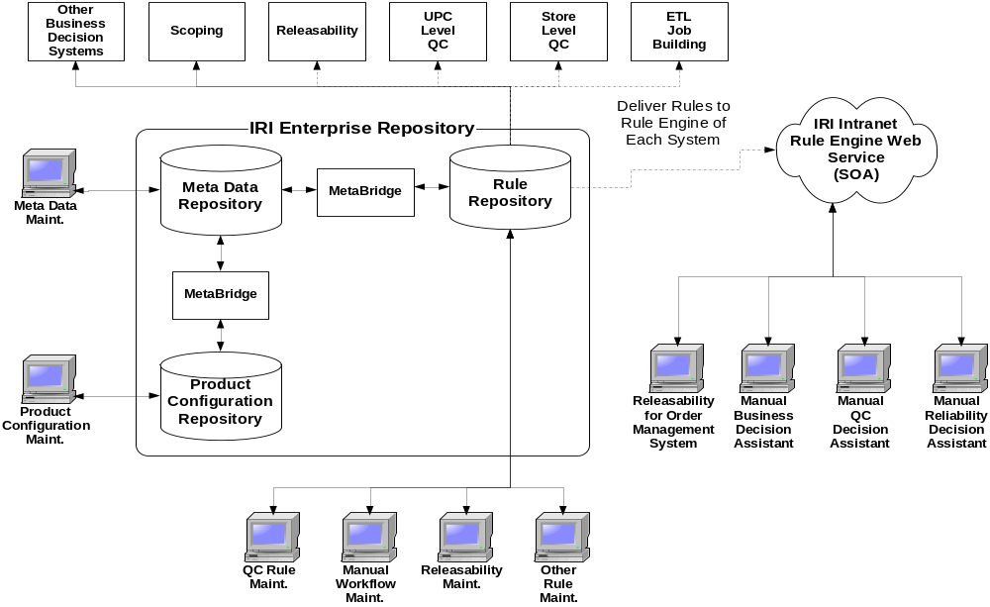
Enterprise Business Rule Architecture

Slide 14
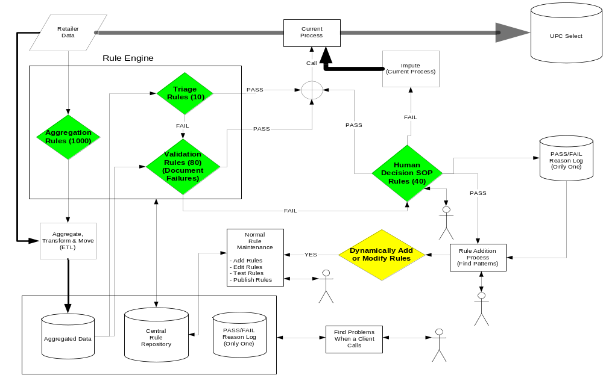
Store Level QC POC Architecture Example

Slide 15
Store Level QC Example Statistics
Today
  4 C Programs & 4 SAS Programs
  SOP for Manual Effort
New On-Demand Factory
  Estimated Number of Business Rules
    Expert System Module – 80 rules
    Triage Module – 10 rules
    Aggregation Module – 1,000 rules (Future Rules to decide on Aggregations)
    SOP Assistant – 40 rules (Might be able to be automated)
Yearly ROI - $396,500 per Year
  $346,500 (70% reduction of Current SLQC error penalties)
  $50,000 (Reduction of 1 FTE)
Cost - $458,800 Initial Cost
  $270,800 (Development)
  $188,000 (Research)
Note: All of the above are estimates and approximations

Slide 16
Estimated IRI ROI
Assumptions
  Revenue of $600M
  New Income of $60M
Total ROI - $2.8M per Year
  Penalty Reduction: $700,000 (Double SLQC)
  FTE Reduction: $1.2M (20 FTE [30% of 68] x $60K)
  Revenue Impact for Fast Turnaround: $300K (0.5% of New Income)
  Operating System Reductions – Less Code Rework - $600K (0.1%)
Net ROI First Year: $1.1M (After Completion)
Note: All of the above are estimates and approximations

Slide 17
Business Rule Management Team Organization
Rule Administrator
  Rule Architects would act as the Rules Administrator
Rule Architect/Knowledge Engineer (Includes Java)
  Count: Initially 5 (Only 2 Ongoing for New Projects & Maintenance)
  Cost: $1.2M Initially followed by $300,000 Ongoing
    Consultants: $780K ($125/Hour Blend for 12 Months Each)
    Consulting Expenses: $117K (15%)
    FTE’s: $260K ($130,000 Loaded Salary Each)
Business Analyst/Domain Expert
  Count: 25
    20 Business Requirements/Week/BA (Initial Implementation)
    50 Business Rules/Week/BA (Initial Implementation)
    75 – 100 Business Rule Changes/Week/BA (Ongoing)
  Cost: Existing Resources
Note: All of the above are estimates and approximations

Slide 18
Estimated IRI Costs
Assumptions
  All Development Finished in 24 Months
  3 Consultants for 12 Months (Local)
Costs: $1.7M
  Software - $518,000 (Ongoing $68,000)
    Development, Production, Repository (Unlimited CPUs) - $450,000
    First Year Maintenance – $68,000
    Unlimited Developers
  FTE Increases: $260K (2 Rule Architects)
  Consulting: $897K (3 Consultants)
  Training: $49K
    BA - $37,500 (3 Days based on $500/Day for Each)
    KE - $ 5,000 ( 5 Days bases on $500/Day for Each)
    Expenses - $6,375 (15%)
Note: All of the above are estimates and approximations (Prices & Costs Have Not been Negotiated)

Slide 19
Why ILOG (References)
Visa
  8 Million Records
  2400 Rules
  19.2 BILLION Rules Evaluated per Hour
Major Healthcare Insurance Provider
  3 Million Claims with 3 Lines per Claim
  2000 Rules Organized in 150 Rule Sets
  9 MILLION Rule Transactions Processed in 10 Hours
Credit Card Marketing Promotion Management
  48 Million Customer Records Processed per Month
  200 Business Rules
  78 THOUSAND Rule Firings per Second
  Integrated with Ab Initio ETL Data Pipe
Major Insurance Company
  IT Support and Maintenance went from 86% to 54% Using ILOG JRules Based Applications
Note: This Information is from ILOG – Needs to be Verified and Tested

Slide 20
Why ILOG (The Company)
Founded in 1987
Publicly Traded
$92.3 Million Revenue for FY03
25% Year Over Year Growth
45% of Income from Business Rules
Over 2,000 Customers
Over 300 ISV/OEM Partners
Sells in 30 Countries
JRules POC Running on a GRID using DataSynapse GridServer
Forming a Partnership with Ascential to Develop a Plug-In for DataStage Parallel Extender (Technical Meetings Have Already Taken Place)
Other Useful Products: Schedule Optimizer, Mathematical Optimizer, Configuration Optimizer

Slide 21
Why ILOG (JRule Features)
Rule Authoring
  Natural Language Rules
  Rule Templates
  Web-Based Authoring
  Full Rule Debugging, Tracing and Validation
Central Repository
  Rule Repository in Oracle
  Where Used for Rules and Business Objects
  Version Control
  Search and Rule Reuse Capabilities
  Rule Publishing
Rule Engine Deployment
  J2EE, J2SE, Web Services
  Embeddable Rule Engine
  Hot Deployment of Business Rules
  Highly Scalable
Integration with Eclipse (Selected Java IDE for IRI)
Integration with Ascential DataStage

Slide 22
Conclusion/Next Steps
Finish Store Level QC POC
Develop New Team
When Store Level QC is Completed Successfully, Do CapEx for ILOG JRules
Purchase ILOG JRules
Develop Standards, Methodologies & Best Practices

